Slide 1
Programming #4, 2026
Accordion with Bootstrap

Slide 2
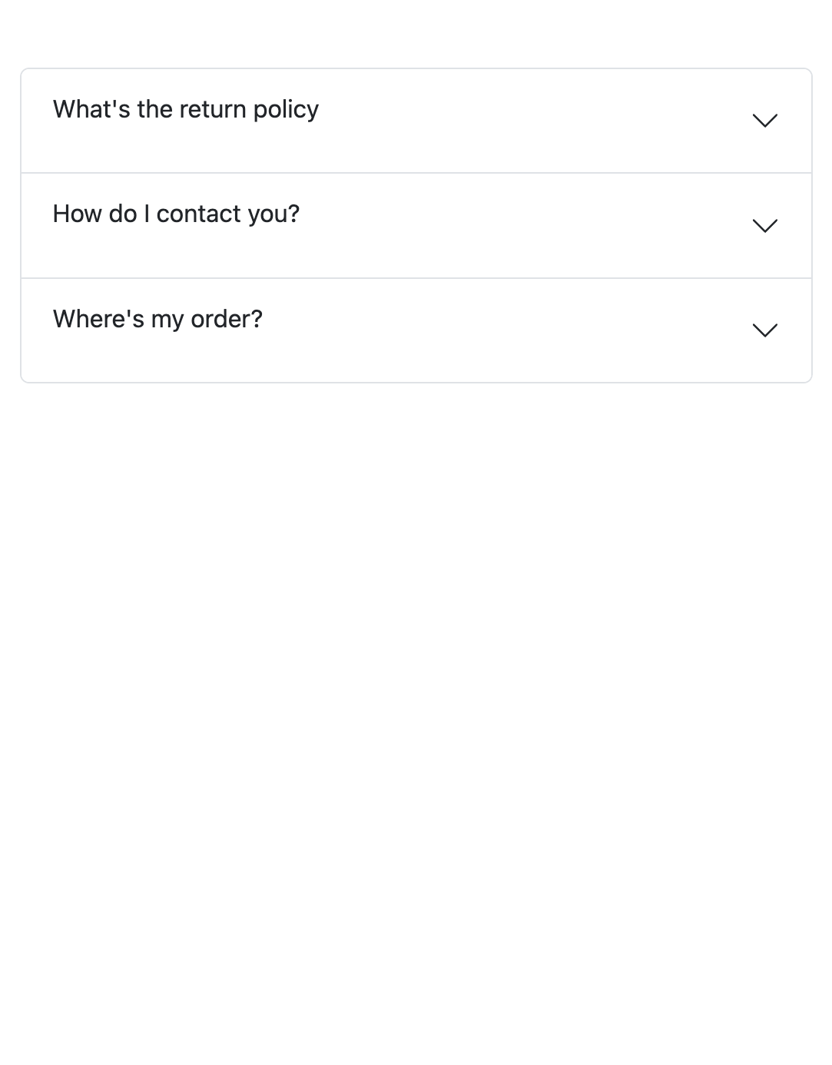
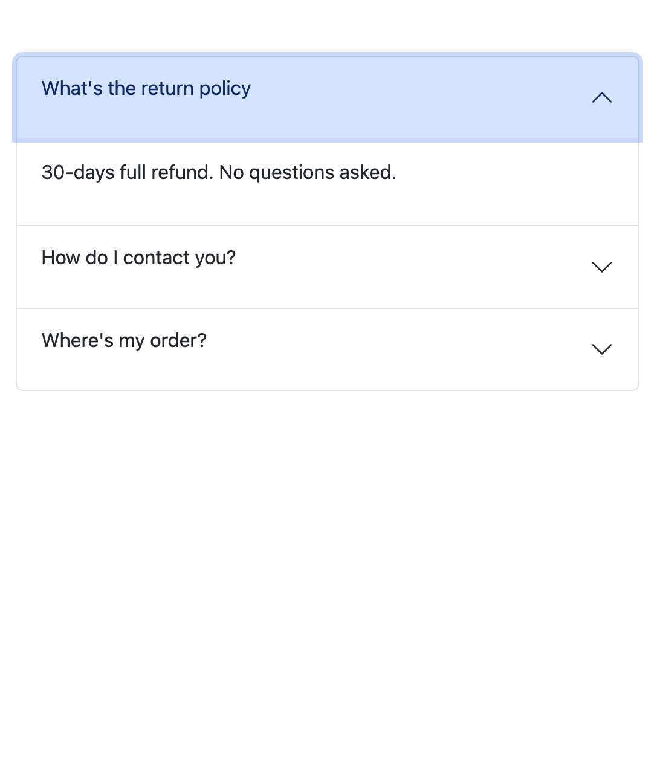
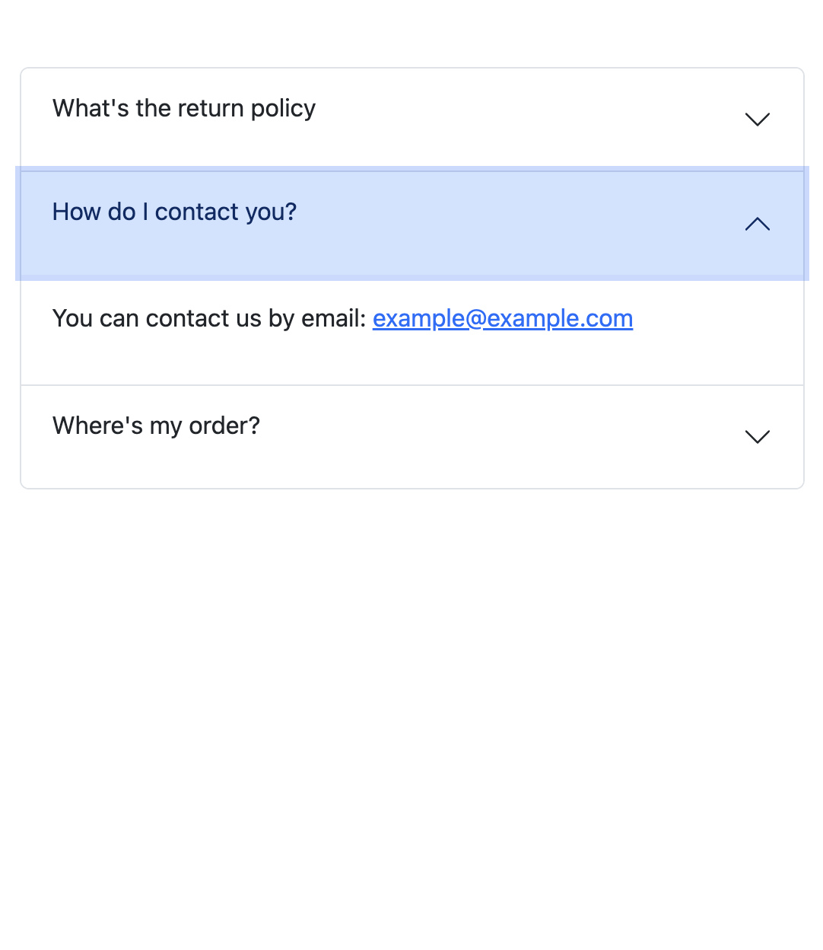
Accordion in its normal state
When one of the accordion items is revealed
Another accordion item revealed, and the rest are closed

Slide 3
Accordion with Bootstrap
An Accordion is a row of ”buttons” that reveals some information when clicked, and hides it when clicked again
These are always created as a pair: button - information
A typical accordion in Bootstrap will always contain the following components inside the parent class of accordion
An accordion-item class: Every entry pair of button – information is a single accordion item
An accordion-header class inside the accordion-item class: This is the heading that contains the accordion button
An accordion-button inside the accordiong-header class: This button controls the hiding and revealing of the information, which is stored in the accordion body
An accordion-collapse class inside the accordion-item class: A container that holds the accordion body. This is the part that collapses and shows when the accordion button is clicked
An accordion-body class inside the accordion-collapse class: Contains the information that is revealed upon clicking the accordion button

Slide 4
A single Accordion Item
<div class="accordion” id=”faqAccordion">
<div class="accordion-item">
<h2 class="accordion-header">
<button class="accordion-button collapsed" type="button" data-bs-target="#faq1" data-bs-toggle="collapse">
<p>What's the return policy</p>
</button>
</h2>
<div class="accordion-collapse collapse" id="faq1" data-bs-parent="#faqAccordion">
<div class="accordion-body">
<p>30-days full refund. No questions asked.</p>
</div>
</div>
<div class="accordion-item"> … </div>
<div class="accordion-item"> … </div>
…
</div>
The parent class that contains all the accordion items
Every single pair is created inside accordion-item
The text inside the button is usually an h2 heading. BS has its special class accordion-header for such heading
BS has a special class accordion-button for the buttons. This creates an accordion specific button with the small arrow on the right corner
The accordion-collapse class creates the “collapsing” behaviour in the accordion
accordion-body is the class reserved for the part where the information is displayed after clicking the button

Slide 5
Accordion button
<button class="accordion-button collapsed"
type="button"
data-bs-target="#faq1"
data-bs-toggle="collapse”>
…
Class | Explanation
collapsed | Tells BS that this button should stay closed when the page loads. BS has a special style for “collapsed” buttons
data-bs-target | Links the button to the accordion-header with the matching ID
data-bs-toggle | Used to change the state of the button from “collapsed” to not collapsed when clicked, and vice versa

Slide 6
Accordion collapsible area
<div class="accordion-collapse collapse”
id="faq1"
data-bs-parent="#faqAccordion">
…
Class | Explanation
accordion-collapse | BS has a specific style for the part that shows the information after the accordion button is clicked.
collapse | Indicates that this area is “collapsible” and meaning it can show and hide content when the accordion button is clicked.
data-bs-parent | Links the item to the main accordion container. This makes sure that only one accordion item is open at a time.

Slide 7
Hiding/Showing accordion item
<div class="accordion-item">
<h2 class="accordion-header">
<button class="accordion-button collapsed" type="button" data-bs-target="#faq1" data-bs-toggle="collapse">
<p>What's the return policy</p>
</button>
</h2>
<div class="accordion-collapse collapse" id="faq1" data-bs-parent="#faqAccordion">
<div class="accordion-body">
<p>30-days full refund. No questions asked.</p>
</div>
</div>
<div class="accordion-item">
<h2 class="accordion-header">
<button class="accordion-button" type="button" data-bs-target="#faq1" data-bs-toggle="collapse">
<p>What's the return policy</p>
</button>
</h2>
<div class="accordion-collapse collapse show” id="faq1" data-bs-parent="#faqAccordion">
<div class="accordion-body">
<p>30-days full refund. No questions asked.</p>
</div>
</div>
When the page loads, this accordion item will be in “closed state” because of the collapsed class and the missing show class
When the page loads, this accordion item will be in “opened state” because of the missing collapsed class and the present show class

Slide 8
End

